Slide 1

NO MEN ARE FOREIGN
JAMES KIRKUP

Slide 2

What image comes to your mind when you think of the word ‘foreign’? How are we different from the people of other nationalities? Do you think these differences should become the factors for discrimination?

Slide 3
CONTEXTUAL WORDS
ALIEN
EXOTIC
EXTRANEOUS
OVERSEAS /INTERNATIONAL
NON-NATIVE

Slide 4
TITLE REFLECTION
Do you think the title holds relevance in the present context?
NO MEN ARE FOREIGN
What themes does this word foreshadow?
How is the word ‘No’ contributing to the tone of the poem?
Reflections on the word ‘men’.
Is the title ‘inclusive’
Can this word help us identify the time period in which the poem was written.

Slide 5
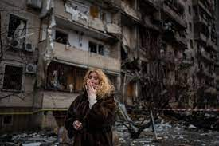
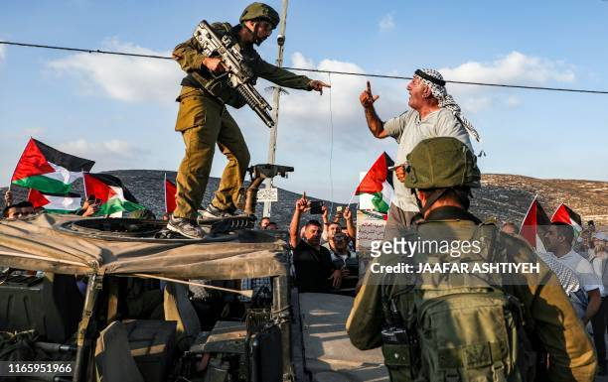
GROUND REALITY (1.0) - WAR OVER BORDERS

Slide 6
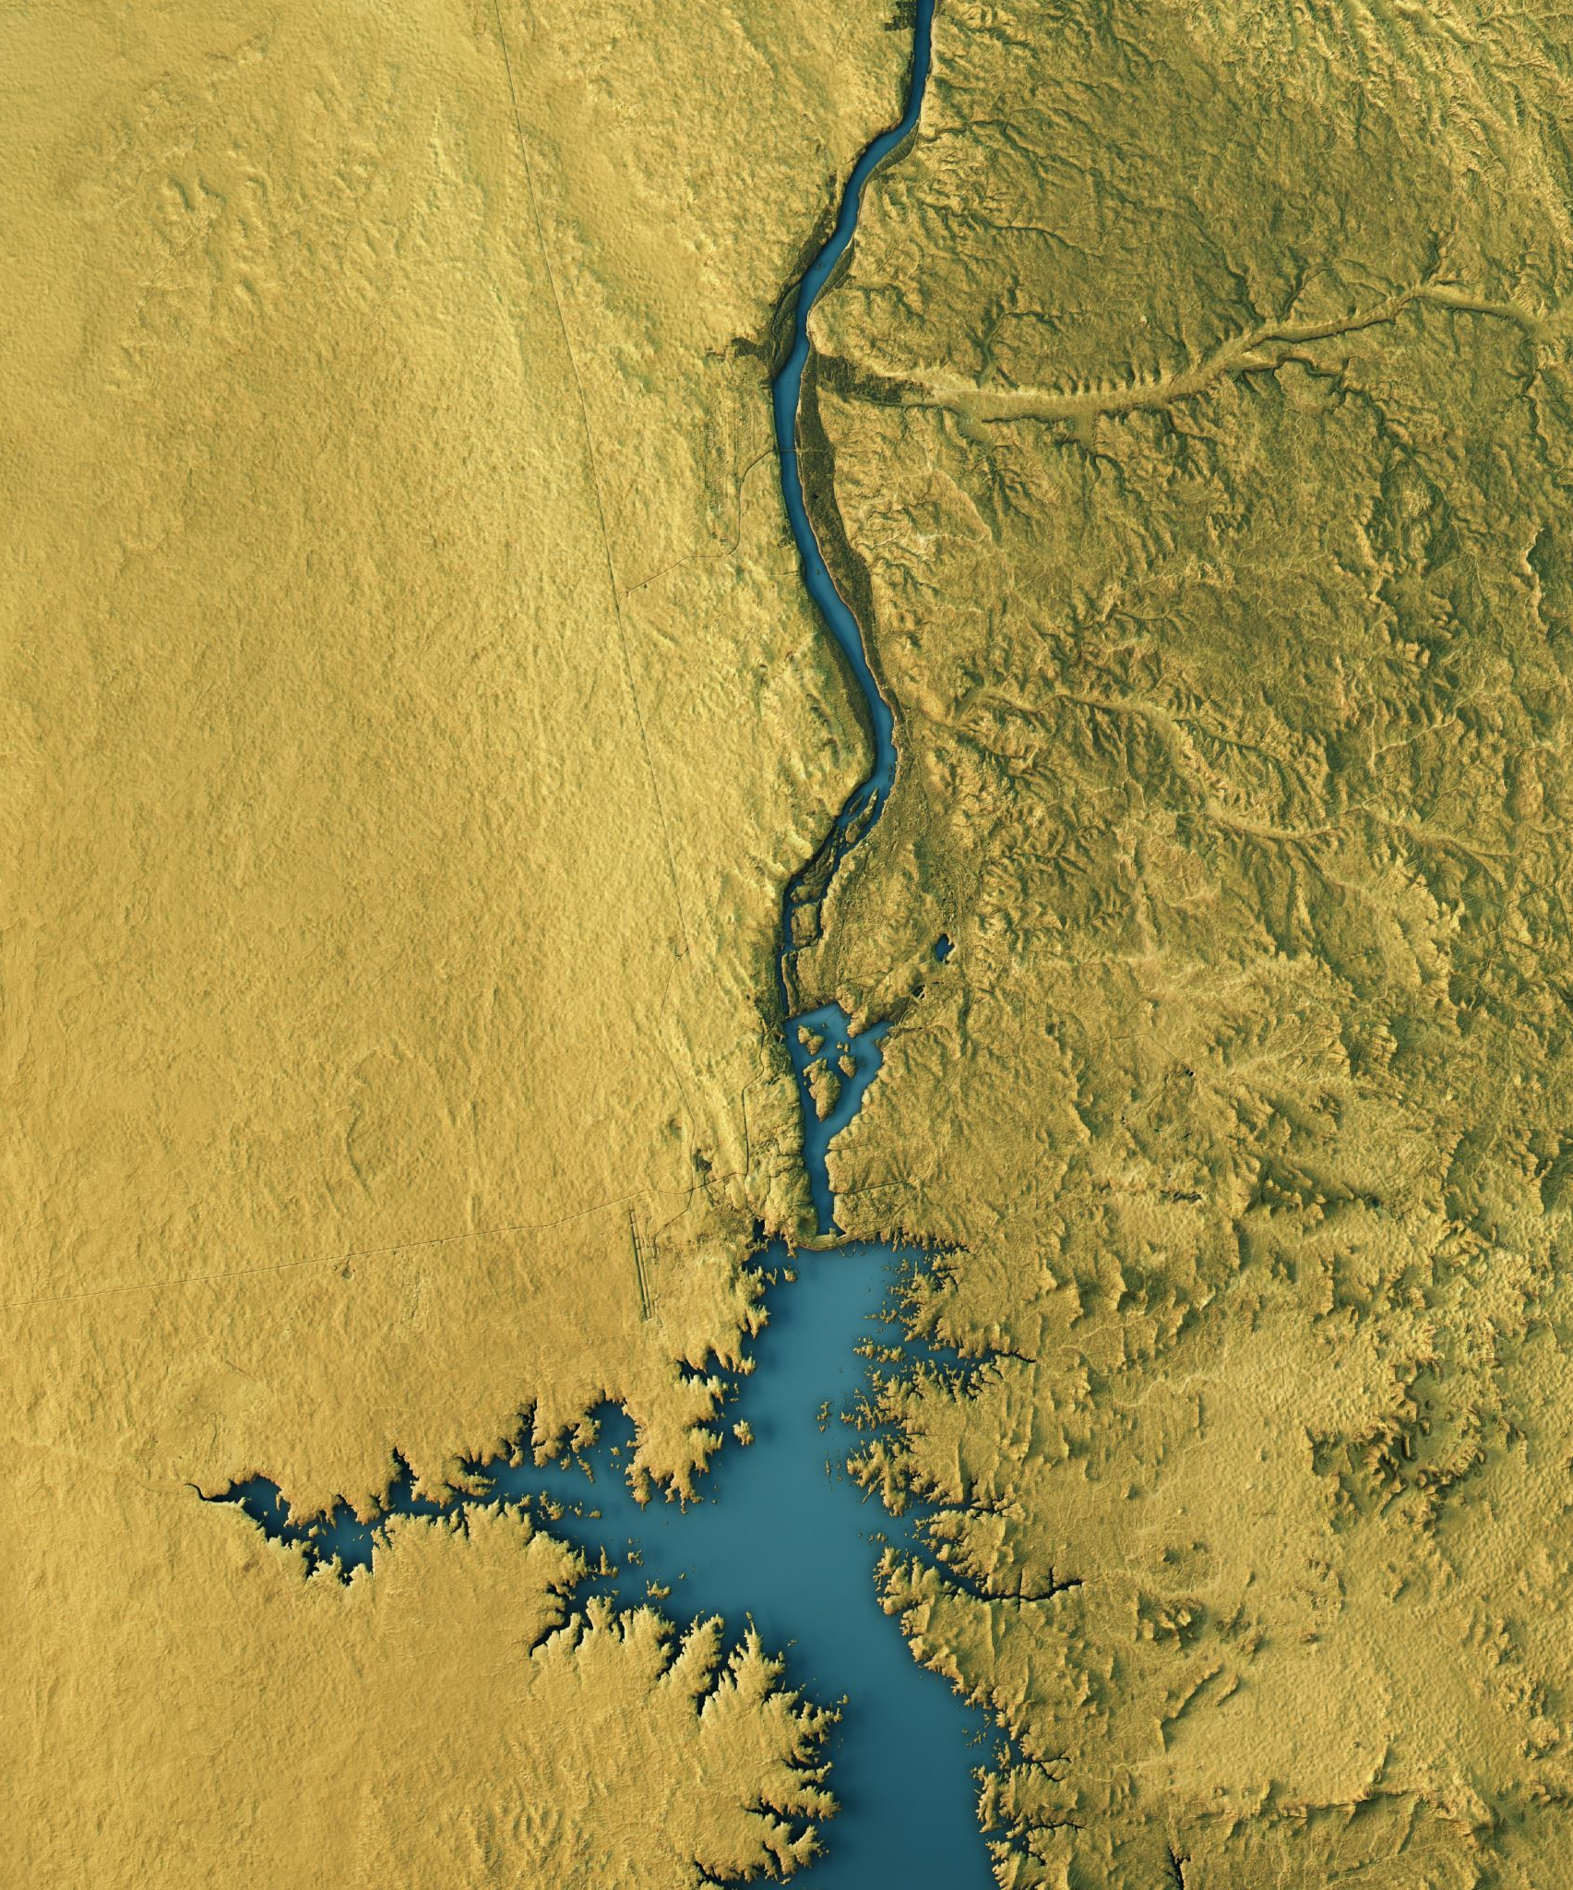
ARE BORDERS REDUNDANT?
CAN WE IMAGINE A WORLD WITHOUT BORDERS?

Slide 7
REFLECTION QUESTIONS
Do you think humans obsess over creating divisions?
Do borders reinstate violence?
How is the idea of division related to the idea of possession and ownership?
Are we too possessive of our nationality?
Think of divisions at home, school, and society.

Slide 8
Ground Reality 2.0 Transcending borders.
At the time when human race is planning to wage wars against nations to establish political domination, there are organizations that are trying to help people beyond ethnic and national lines.
Medicins sans frontiers(Doctors Without Borders) is an independent medical humanitarian organization founded in 1971. It won the Nobel Peace Prize in 1991. MSF provides relief to those affected by war, natural disasters or disease outbreaks.
https://www.youtube.com/watch?v=UsJbpRpB2V0

Slide 9
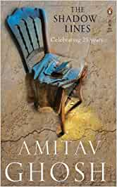
LITERATURE SPEAKS:
Here are some pieces from literature that speak to the absurdity of having borders. Reflect on the following lines taken from Amitav Ghosh’s The Shadow Lines.
They know they're a nation because they've drawn their borders with blood […] War is their religion. That's what it takes to make a country. Once that happens people forget they were born this or that, Muslim or Hindu, Bengali or Punjabi: they become a family born of the same pool of blood. That is what you have to achieve for India, don't you see?
They had drawn their borders, believing in that pattern, in the enchantment of lines, hoping perhaps that once they had etched their borders upon the map, the two bits of land would sail away from each other like the shifting tectonic plates of the prehistoric Gondwanaland.

Slide 10
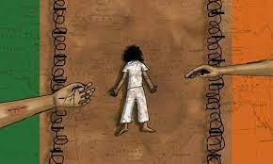
Toba Tek Singh- Saadat Hasan Manto
After fifteen years on his feet, he was lying face down on the ground. India was on one side, behind a barbed wire fence. Pakistan was on the other side, behind another fence. Toba Tek Singh lay in the middle, on a piece of land that had no name.
Reflect on the above lines. Notice the symbolism in the last line. How are borders responsible for the creation of national identity? Can you imagine yourself without a national identity?

Slide 11
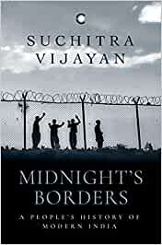
Suchitra Vijayan- Midnight’s Borders
A journalistic narrative written on people who live in the remote border towns, this meticulously written piece deals with the the question of how borders reinstate violence.

Slide 12


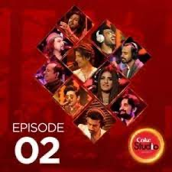
MUSIC ECHOES: Here are some songs that defy the idea of borders and encourage cosmopolitanism
Bob Dylan-Blowing in The Wind
https://youtu.be/n3-qSfoJ7IM?si=_1faXbkQTS0H682v (Optional; Hindi-Urdu Song)

Slide 13
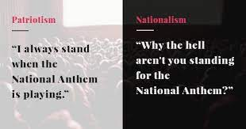
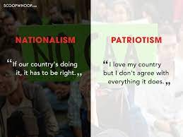
NATIONALISM, PATRIOTISM,AND JINGOISM

Slide 14
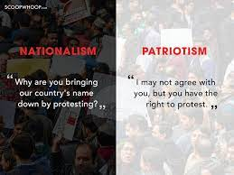
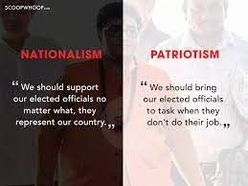

Slide 15
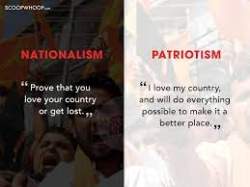
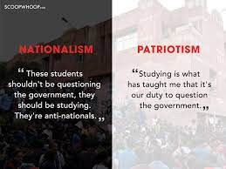

Slide 16
Spirit of Patriotism and Cosmopolitanism
is a positive form of expressing love
Is inclusive and welcomes diversity
allows questioning and dissent
Believes in the idea of universal brotherhood and fraternity
Allows learning and taking inspiration from other countries
does not allow irrelevant obsession over borders and boundaries.
TRY TO IDENTIFY THE TONE AND INTENT OF THIS POEM.
DOES THE POET PROPAGATE NATIONALISM, PATRIOTISM OR COSMOPOLITANISM

Slide 17
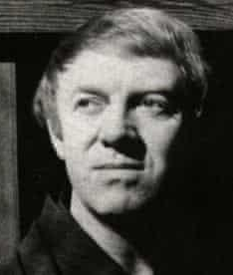
ABOUT THE POET
James Harold Kirkup, FRSL (23 April 1918 – 10 May 2009). He was an English poet, translator and travel writer. He wrote over 45 books, including autobiographies, novels and plays. He wrote under many pen-names including James Falconer ,Aditya Jha, Jun Honda, Andrew James, Taeko Kawai, Felix Liston, Edward Raeburn, and Ivy B. Summerforest. He became a Fellow of the Royal Society of Literature in 1962.

Slide 18

CONTEXT OF THE POEM.
The poem is said to be written around 1940s and was published in 1966. Research on the social and political history of the time when the poem was written.

Slide 19

TITLE OF THE POEM!
Share your views on the title of the poem.
What does the poet wish to suggest through the title?
How are we similar despite the difference in our national identities?

Slide 20
Poem - No Men Are Foreign. (1st Reading)
Purpose: Identify Word Clusters
Remember, no men are strange, no countries foreign (Purpose of the word- Remember) Beneath all uniforms, a single body breathes. Like ours: the land our brothers walk upon Is earth like this, in which we all shall lie. They, too, aware of sun and air and water, Are fed by peaceful harvests, by war’s long winter starv’d. Their hands are ours, and in their lines we read A labour not different from our own.

Slide 21
Remember they have eyes like ours that wake Or sleep, and strength that can be won By love. In every land is common life That all can recognise and understand. Let us remember, whenever we are told To hate our brothers, it is ourselves That we shall dispossess, betray, condemn. Remember, we who take arms against each other It is the human earth that we defile. Our hells of fire and dust outrage the innocence Of air that is everywhere our own, Remember, no men are foreign, and no countries strange.

Slide 22
Read and Reflect!
Remember, no men are strange, no countries foreign Beneath all uniforms, a single body breathes Like ours: the land our brothers walk upon Is earth like this, in which we all shall lie.
The poem begins with an imperative command, “Remember”. Can you identify the poetic device?
What does the poet mean by, “beneath all uniforms a single body breathes”? What uniforms is he talking about?

Slide 23
They, too, aware of sun and air and water, Are fed by peaceful harvests, by war’s long winter starv’d. Their hands are ours, and in their lines we read
Remember they have eyes like ours that wake Or sleep, and strength that can be won By love. In every land is common life That all can recognise and understand.
What does the poet mean by , “war’s long starved winter”? Why is war being compared to winter? Comment on the nature of comparison.
The poet is constantly reinstating the similarities between people separated by borders. What does it signify?

Slide 24
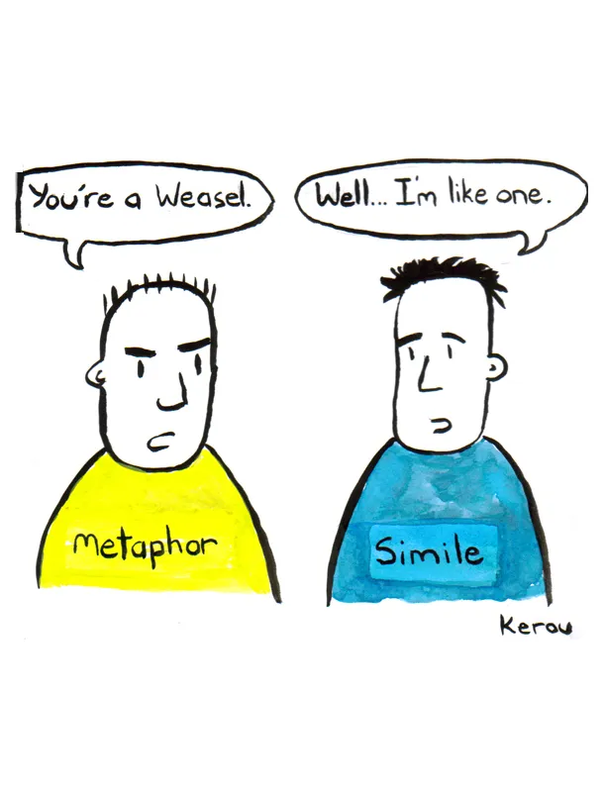
METAPHORS AND SIMILIES

Slide 25

Why do we need figurative language in poetry?
Revisiting Metaphors and Similes in Detail

Slide 26
POETIC DEVICES
SIMILIE
METAPHOR
Direct comparison
Two distinct objects could be compared using ‘like’, ‘as’, ‘seem’
Example:
Day after day, day after day,
We stuck, nor breathe nor motion,
As idle as a painted ship,
Upon a painted ocean (The rime of the Ancient Mariner, Coleridge)
Indirect Comparison
A metaphor is more of a fusion of two elements. It comes from a Greek word, which means, ‘carry across’ or ‘transfer’
For example:
The children are blossoming.
The line suggests the growth of children without the use of word ‘growing’.

Slide 27
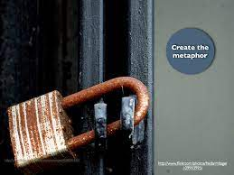
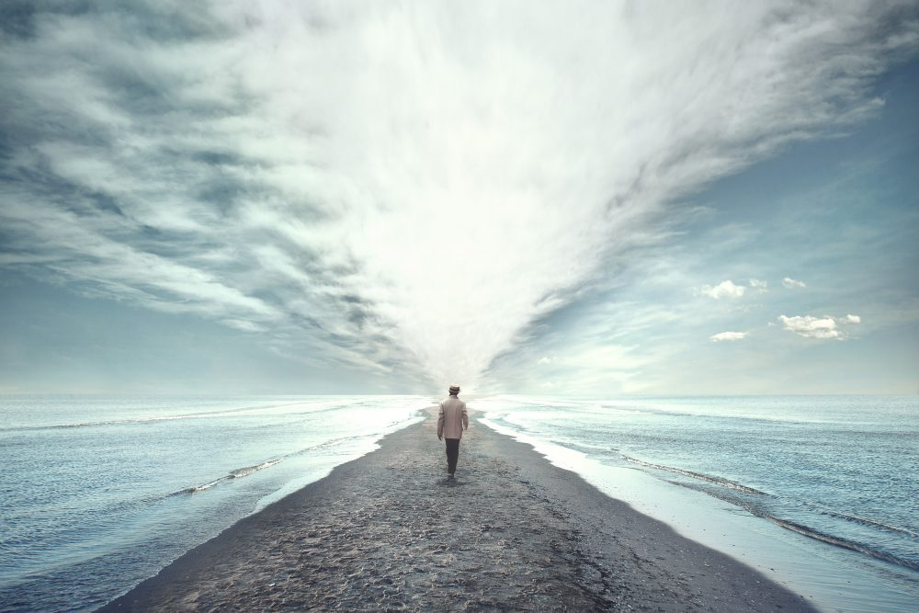
CREATE METAPHORS USING THESE IMAGE PROMPTS!

Slide 28
Reflect on the central message of the poem through these lines.
Let us remember, whenever we are told To hate our brothers, it is ourselves
That we shall dispossess, betray, condemn. Remember, we who take arms against each other It is the human earth that we defile. Our hells of fire and dust outrage the innocence. (Hells of fire? ; innocence of air; Reflect) Of air that is everywhere our own, Remember, no men are foreign, and no countries strange.

Slide 29

Revisiting Themes

Slide 30
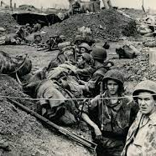
FUTILITY OF WARS
Wars serve no purpose. There is loss of life and property and it benefits neither of the countries involved. The direct consequence is wastage of manpower and resources. ... Therefore, wars are just pointless and serve no purpose. In the poem, the wars are compared to long starved winters.

Slide 31

UNIVERSAL BROTHERHOOD

Slide 32
Nature transcends the differences based on geography, race and religion.
How can we recognize and understand ‘common life’ in every land?

Slide 33

CRITIQUE OF NATIONAL AND ETHNIC IDENTITIES
The poem critiques ethnic discrimination by mentioning the common traits of all human beings. The poem encourages the reader to look beyond race, nationality and ethnicity.

Slide 34
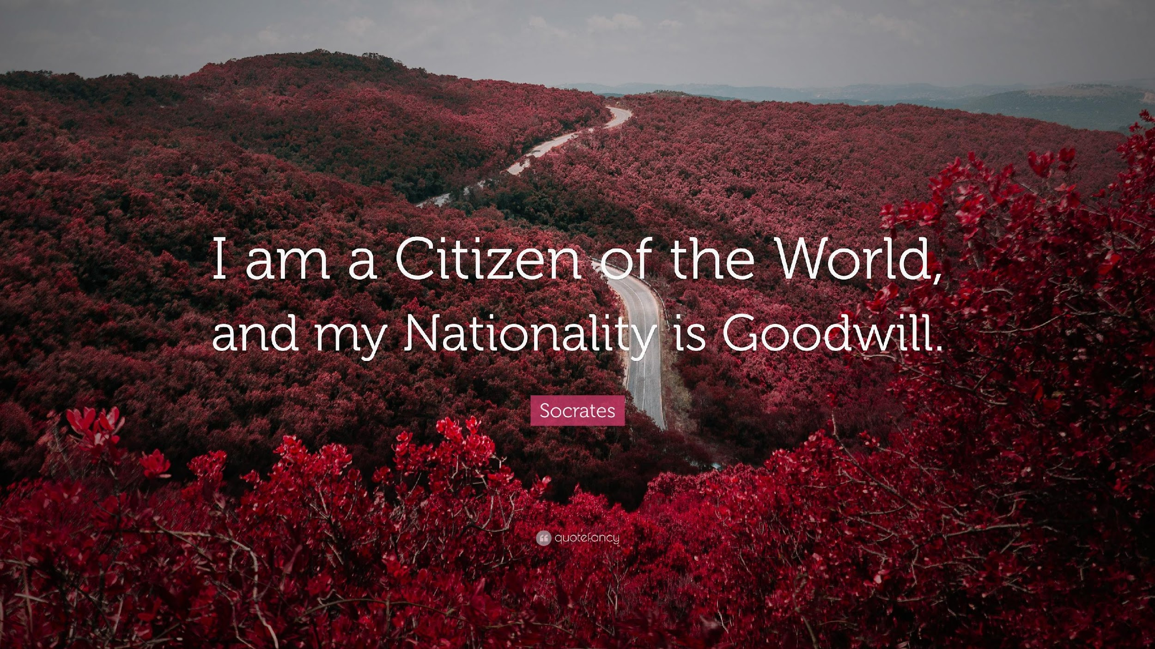
Re-imagining Citizenship!
Literature allows one to reimagine a world without boundaries.
It ingrains the idea of global citizenship.
It strives to build a sense of belongingness with the world.
This poem asks us to reimagine our position in this world and the need to go beyond our nationalist interests.
Can you imagine yourself as a citizen of the world?

Slide 35
Additional Poem:War Photograph
beneath her picture
in a weekly magazine.
All over the country
we're feeling sorry for her
and being appalled at the war
being fought in the other world.
She keeps on running, you know,
after the shutter of the camera
clicks. She's running to us.
For how can she know,
her feet beating a path
on another continent?
How can she know
what we really are?
From the distance, we look
so terribly human.
She is running from the smoke
and the soldiers, from the bodies
of her mother and little sister
thrown down into a ditch,
from the blown-up bamboo hut
from the melted pots and pans.
And she is also running from the gods
who have changed the sky to fire
and puddled the earth with skin and blood.
She is running--my god--to us,
10,000 miles away,
reading the caption
A naked child is running
along the path toward us,
her arms stretched out,
her mouth open,
the world turned to trash
behind her.

Slide 36
CULMINATING ACTIVITY AND CONCLUDING NOTE
Task: Write a comparative analysis of the two poems. Keep the content, structure, imagery, poetic devices in mind.
Concluding Address: Discussion Points:
Do you think Kirkup’s vision homogenizes and dilutes the concept of cultural diversity and ethnic representation by categorising everyone as similar in all aspects?
Do you think Kirkup’s poem is an oversimplification of International Relations. Why/Why not?

Slide 37
Question and Answers:
Ques 1: “whenever we are told to hate our brothers…”
When do you think this happens? Why?
Who tells us? Should we do as we are told at such times?
What does the poet say?
Ques 2: How does the poet prove that that there are no foreign countries?
Ques 3: What does the poet ask us to remember in the last stanza?
Ques 4: How are we responsible for war?
Ques 5: How do all men living on the earth share same fate?

Slide 38
The poet
S.D.G
Themes?
Life Lessons
MIND MAP
What is the structure of the poem?
Poetic Devices
What does the poet ask us to remember?

Slide 39
THANK YOU

